Slide 1

RETENTION RATE
CUSTOMER RETENTION ANALYSIS
2017
ETUK GODSPOWER

Slide 2
OBJECTIVES
1. This Analysis is to find the customer Retention Rate by
State
Quarter
Wealth Segment
Tenure of Customers
2. To Find the Brand that made an increase in the Fourth Quarter compared to the first Quarter

Slide 3
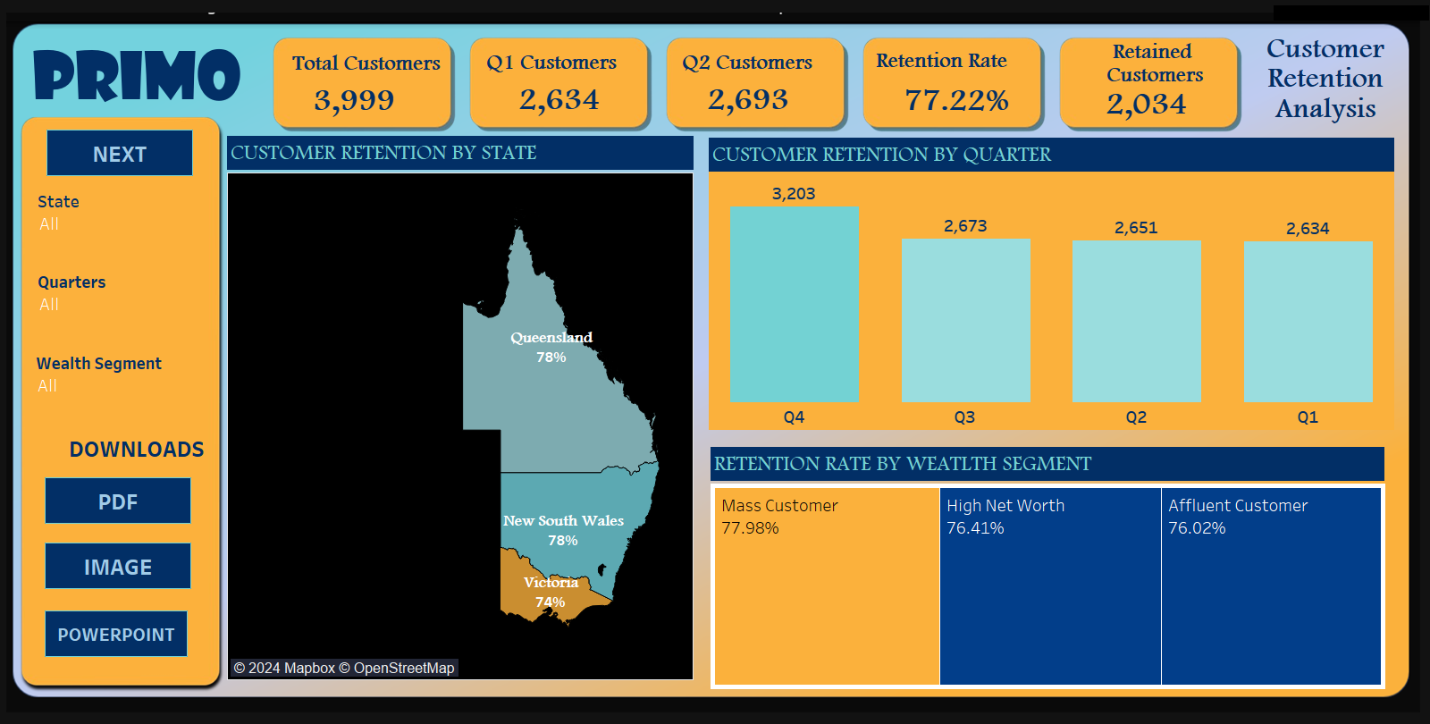
Customer Retention By State
The States with the highest Retention Rate were Queensland and New South Wales, having a 78% retention Rate after some Research

Slide 4
Customer Retention By Quarter
The Quarter with the Highest customer retention was the Fourth Quarter with other quarters having a steady rate of customer flow due to various reasons
The Brand quality
Wealth Segment
Tenure Of Customers

Slide 5
Customer Retention By Quarter
Retention Rate by Wealth Segment was the highest at “Mass Customer” customer taking 77.98% although the difference between the segments isn’t Significant meaning they have high retention rate over all categories.

Slide 6
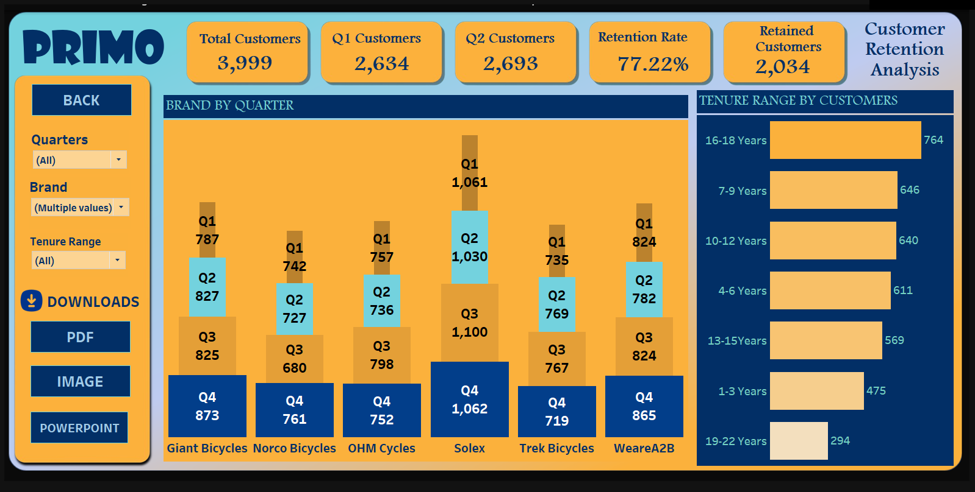
Brand Transactions By Quarter
This was to find the brand with the most transactions to check which brand made customers come back for more transactions.
Factors:
Product Quality
Product Line
Brand Awareness

Slide 7
Number Of Customers By Tenure
The Number Of Customers that had a High Tenure range took majority of the Retained customers. This accounts to why they have a high retention rate
Factors:
Product Line
Customer Services(Workers)

Slide 8
Recommendations
Customer Treatment
Create Incentives for Customers to buy more at a Discounted Rate
Appreciating Customers using Prizes or Gifts to Acknowledge Their Patronage
Seek customer feedback on the products bought.
Seek Customer Feedback in Services rendered
Products
Make advisory Comments on the product manufacturers such as modifications about the brand gotten from the comments of the customers.
Solex Being the highest Brand with the most transactions each quarter should be invested in due to:
Might be the reason customers come back to buy more due to the quality of the product
Brand Awareness of the product

